Slide 1
STUDENT AND CLO MANAGEMENT SYSTEM
BY: 2020-CS-10

Slide 2
ABOUT THE PROJECT
This project is aimed to develop such a system that manages the student data, attendance , create different assessments and generate their reports. This project will be helpful for teachers to maintain information of students and different assesments, clos. There are 5 options. Manage Student, Manage CLO, Manage Rubric and their levels , Manage Assessments and their components and generate reports. In manage student option, user can add student,can add their date wise attendance,add class attendance date and generate student result according to the assessments he/she has attempted.User can update delete these all informations. In Manage Clo, user will add clo and its details and can update and delete these Clos. In Manage rubric option, user can add multiple rubrics of selected clo and assign these rubrics different measurement levels. In manage assessment, user will add assessments and assign its components different marks.In generate report, user will select given reports and it will be generated.

Slide 3
PROJECT DESIGN
OOP And Database
PROJECT LANGUAGE
C#

Slide 4
FEATURES
01

Slide 5
STUDENT
Add Student
Student Attendance
Class Attendance
Student Result
Update/Delete

Slide 6
CLO
Add CLO
Update/Delete

Slide 7
RUBRIC
Add Rubric
Add Rubric Level
Update/Delete

Slide 8
Assessment
Add Assessment
Add Assessment Component
Update/Delete

Slide 9
Generate report
PDF report

Slide 10
02
UI

Slide 11
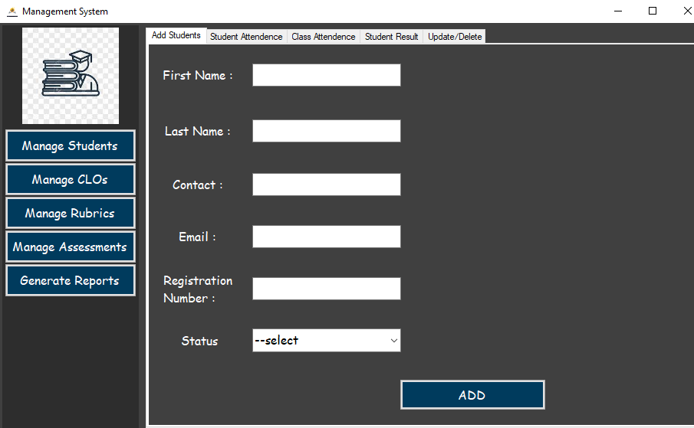
ADD STUDENT

Slide 12
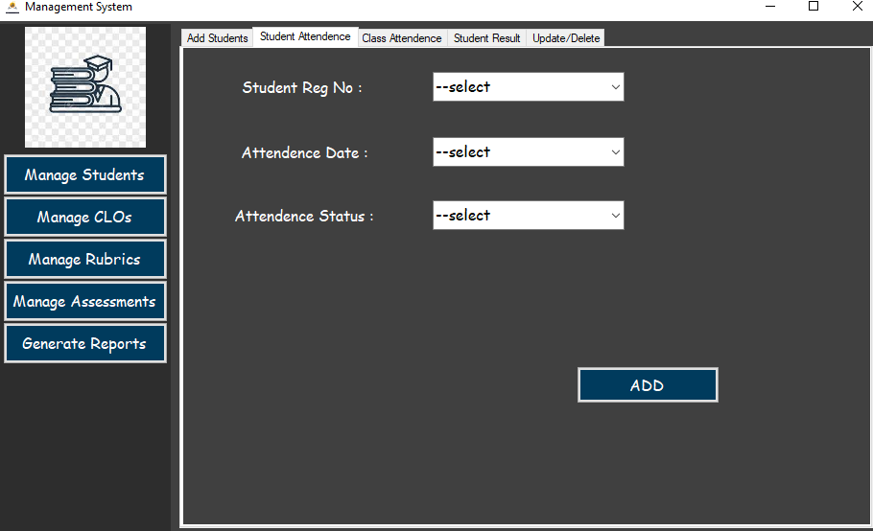
STUDENT ATTENDANCE

Slide 13
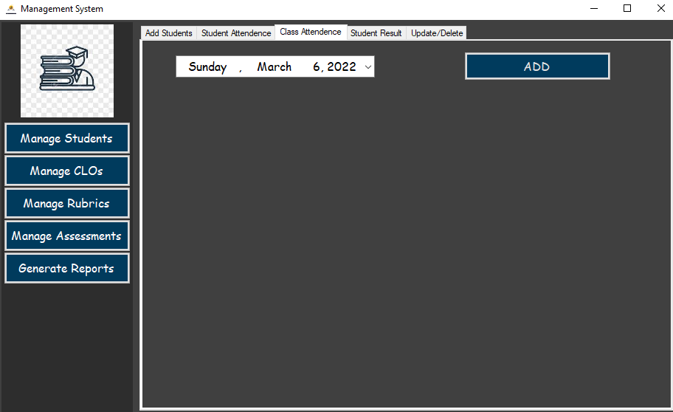
CLASS ATTENDANCE

Slide 14
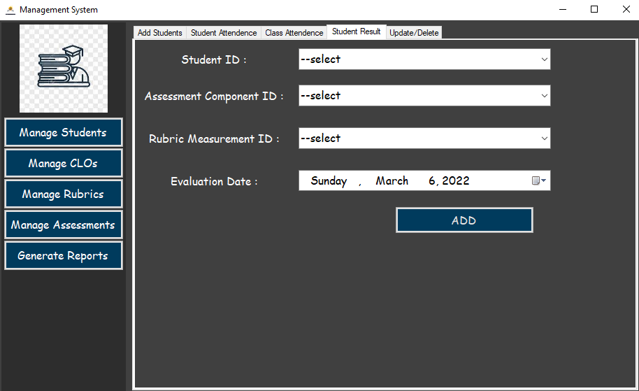
STUDENT RESULT

Slide 15
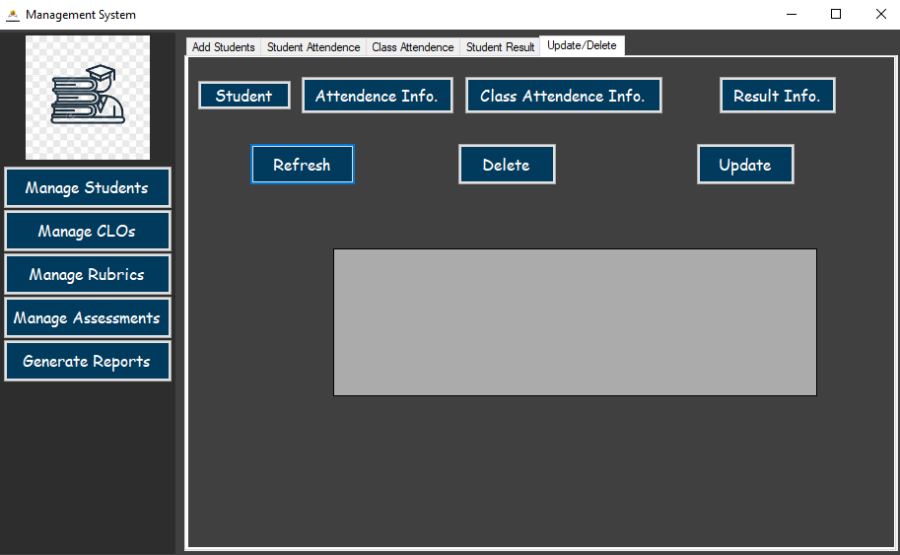
UPDATE/DELETE

Slide 16
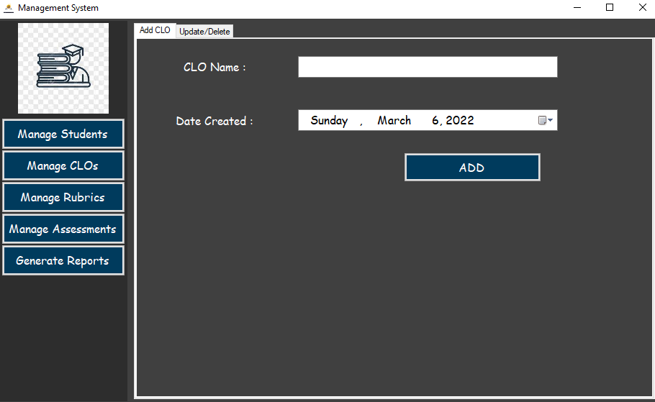
ADD CLO

Slide 17
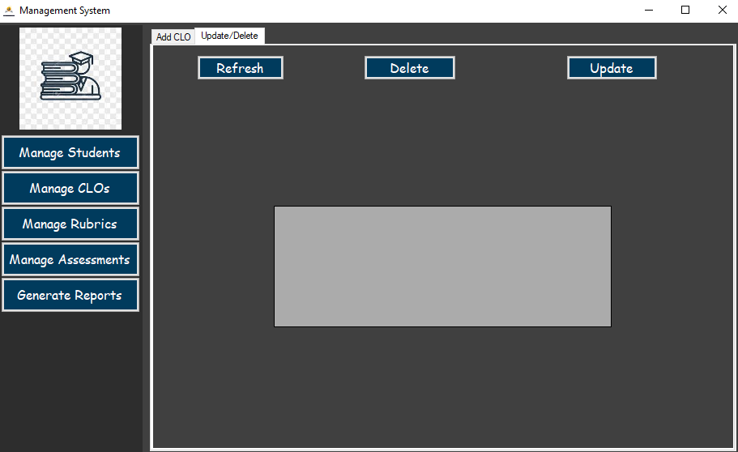
UPDATE/DELETE

Slide 18
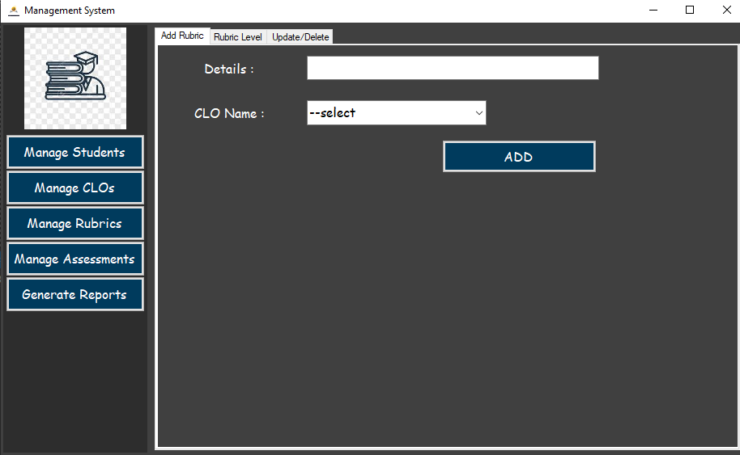
ADD RUBRIC

Slide 19
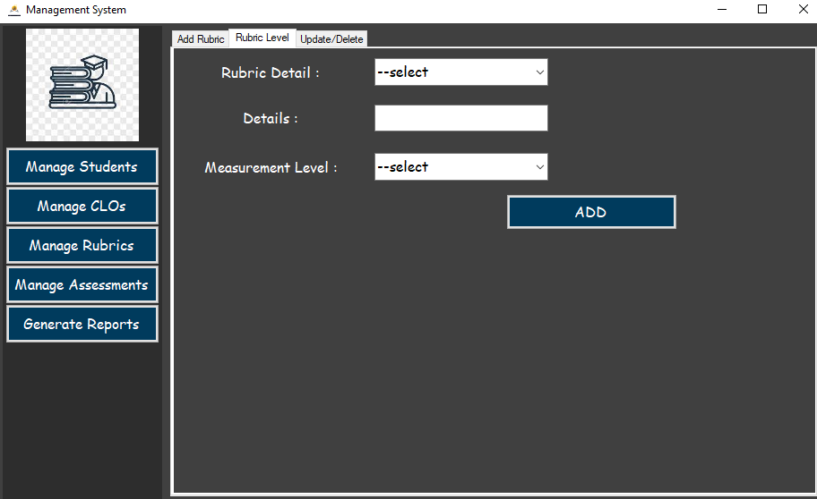
RUBRIC LEVEL

Slide 20
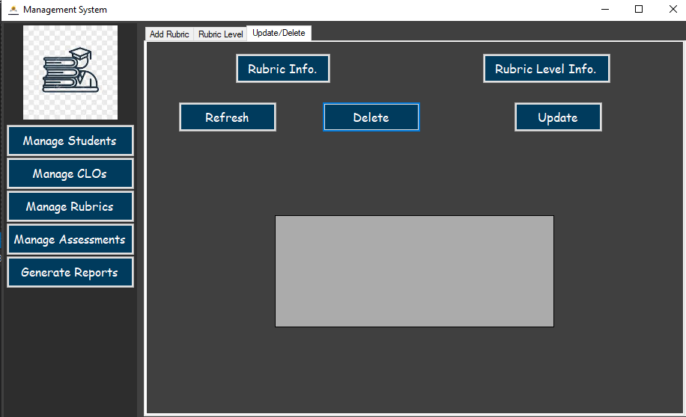
UPDATE/DELETE

Slide 21
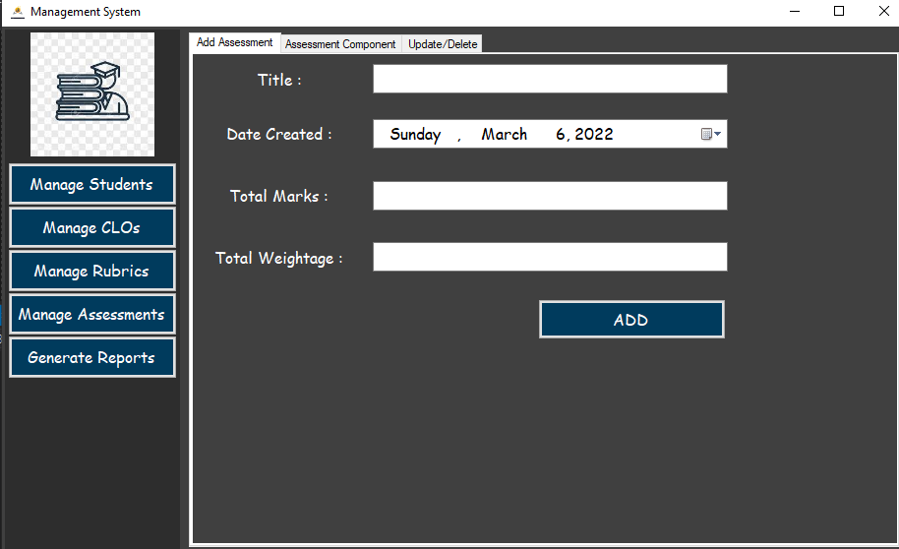
ADD ASSESSMENT

Slide 22
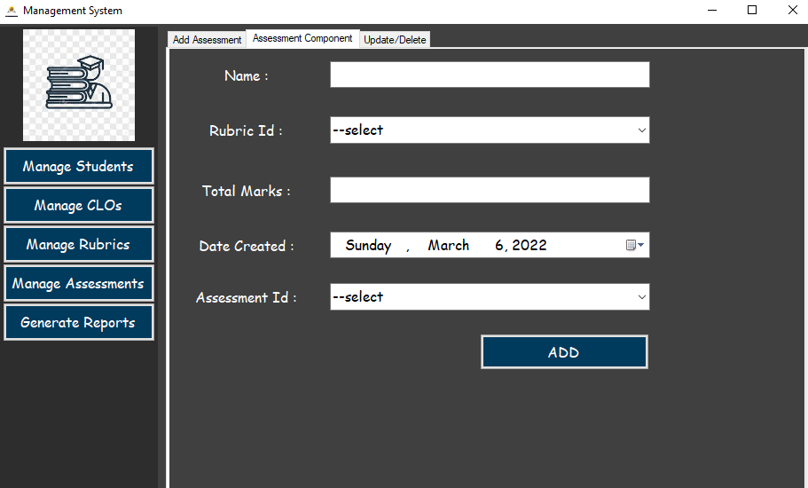
ASSESSMENT COMPONENT

Slide 23
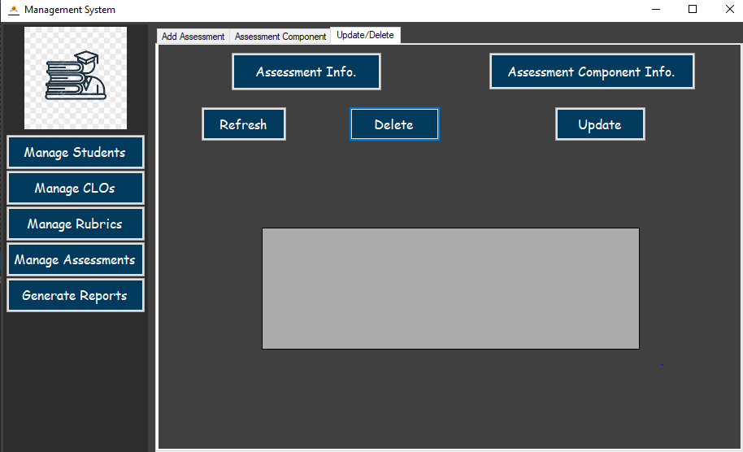
UPDATE/DELETE

Slide 24
FUTURE APPROACH
Will try to make validations more efficient
Will try to use improve data retrieval from data table.

Slide 25
Thanks!
Project Designed by:
Asad Mehmood
2020-CS-10
2020cs10@student.uet.edu.pk

